Slide 1
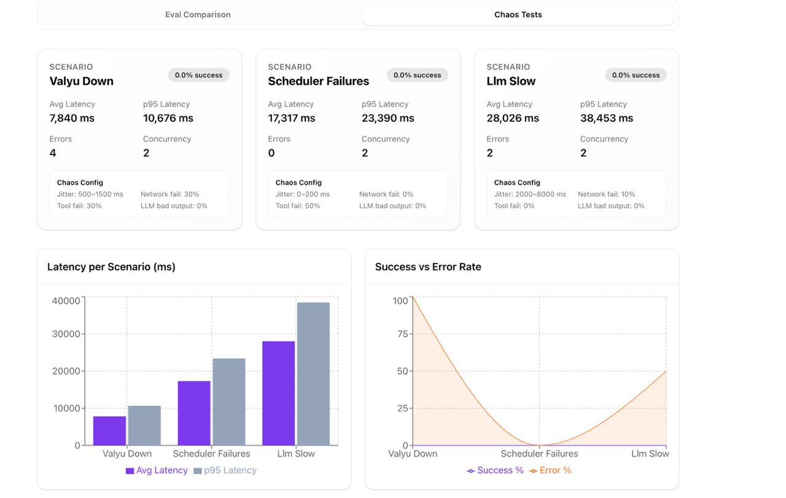
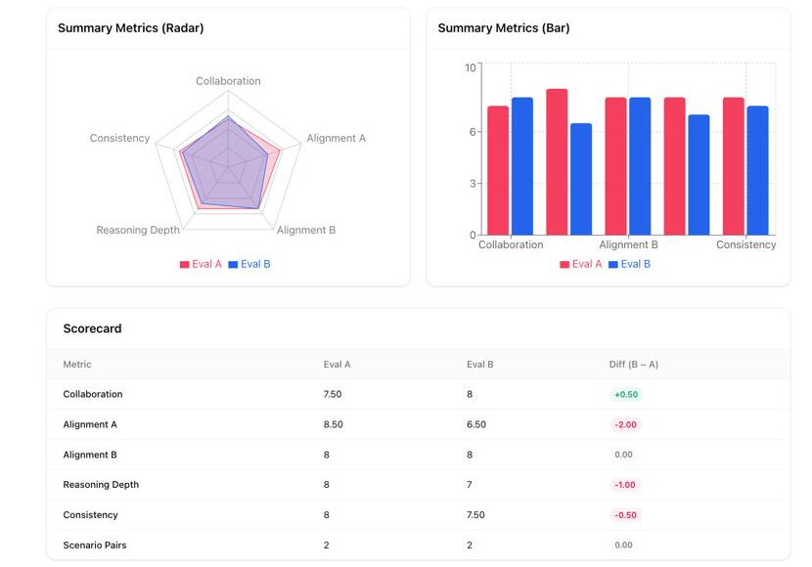
LIFE 2.0
Latency & Runtime Optimization for Dual-Agent Workflow
87% faster, 69% token saving
BEFORE
AFTER
300s / 29K tokens
🔧 Baseline & Configuration Tightening
✂️ Prompt & Phase-Level Optimization
🛠️ Conversation & Tool Strategy Adjustments
⚡ Model Choice & Hybrid Strategy
📏 Hard Limits on Length & Steps
🛡️ Safety & Regression Checks
40s / 9K tokens
Chaos & Robustness Testing: Reliability
METHODS
RESULTS
🌩️ LLM Failure Injection
🔧 Tool Failure Injection
🌐 Network Chaos
⚔️ Combined Chaos Scenarios
Eval Testing: Transparency & Safety
BEFORE
AFTER
🔀 Plans drift from conversation
🚫 Missing or hallucinated steps
🪢 Reasoning not fully connected
🟥 Fewer judge-preferred runs

